Slide 1

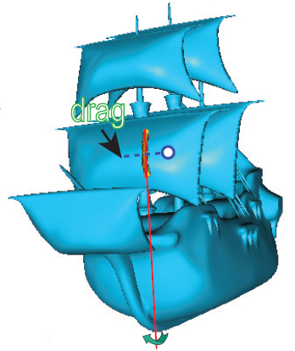

Interactive Axis-Based 3D Rotation Specification Using Image Skeletons
Xiaorui Zhai¹, Xingyu Chen^{1,2}, Lingyun Yu¹, and Alexandru Telea³
¹Bernoulli Institute, University of Groningen, the Netherlands
²University of Science and Technology Beijing, China
³Utrecht University, the Netherlands

Slide 2


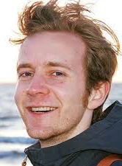





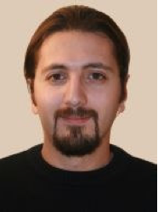
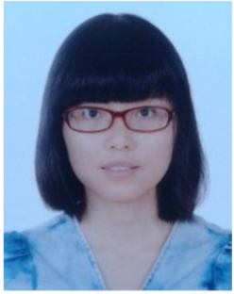


















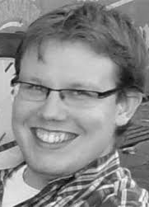
Introduction
Who am I?
PhD in scientific visualization (TU Eindhoven, 2000)
assistant professor in visualization (TU Eindhoven, 2000-2007)
professor in multiscale visual analytics (RUG, 2007-2019)
professor in visual data analytics (UU, since 2019)
28 PhD students, 70+ MSc students
research: visual analytics, shape analytics, machine learning
http://www.staff.science.uu.nl/~telea001
www.solidsourceit.com
Data Visualization: Principles and Practice A. K. Peters, 2008 / 2014

Slide 3

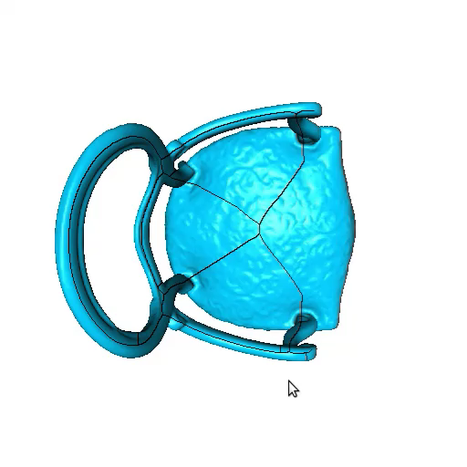
Problem
Rotating 3D shapes around arbitrary axis is not easy to do.
Trackball Rotation
How to easily rotate a shape in 3D?
Notes:
The problem we are trying to solve is very simple: Imagine you have a 3D shape that you want to rotate to view from a specific viewpoint. How to EASILY do this? The typical mechanisms are either not precise (virtual trackball) or not flexible enough (axis-aligned rotations).
So, how can we do better?

Slide 4
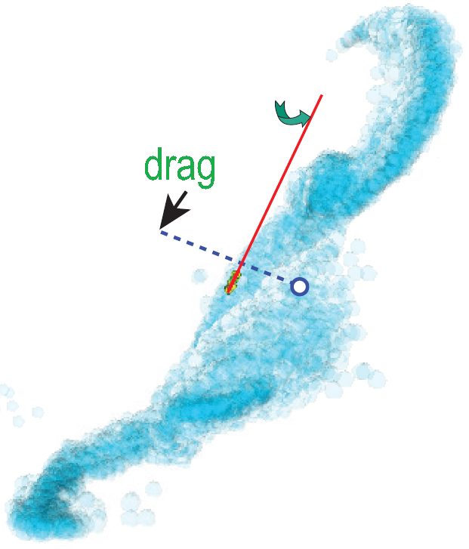
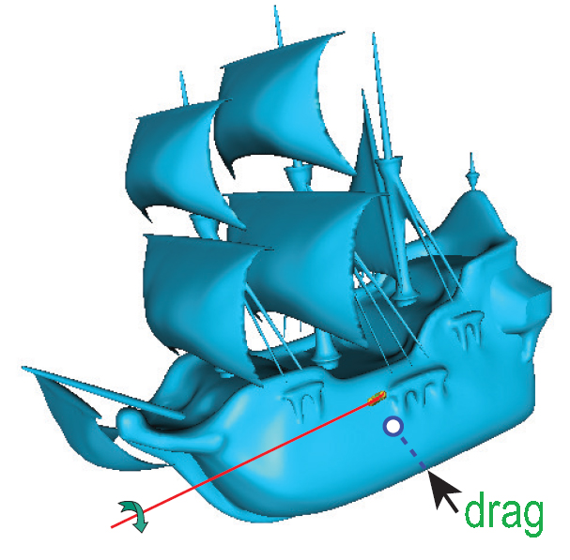
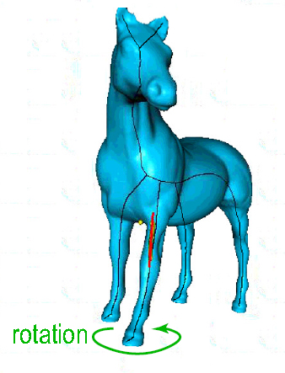
Contributions
A new 3D rotation method
Around natural axes of 3D shapes
Real-time
Works for any 3D scenes
Needs just 1 click
Notes:
We propose here a novel interactive method to rotate a shape around its natural symmetry axes.
The main intuition of our method is simple: Imagine you grab a 3D object with your hand to manipulate it. Then, likely, you will turn the object around its main parts, to look around it.
Our method has several attractive points:
It works in real time even for big geometries (hundreds of thousands of polygons or more)
It can handle any 3D scene (polygon mesh, polygon soup, splats – anything that renders into the framebuffer and Z buffers is supported).
It is easy to use: just click and drag to rotate.

Slide 5
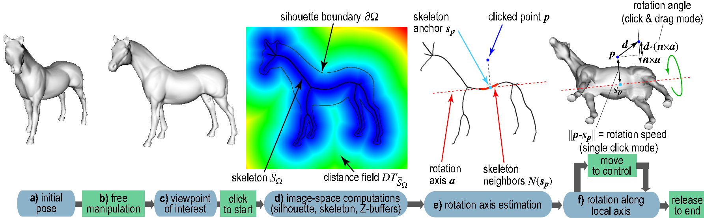
Overview of method
Skeleton-based local rotation pipeline
Notes:
Here is an overview of the method:
We start by any 3D viewpoint of some scene or shape (a)
Then, we use any existing manipulation method (b) to select a reasonable viewpoint that we want next to explore in more detail. For instance, we use trackball to get the viewpoint (c) in which the horse’s rump is well visible
Next, we perform several image-space computations to compute the 2D skeleton of the current silhouette (d)
From this skeleton, we next estimate a 3D skeleton; from the 3D skeleton, we extract a local axis of rotation (e)
We now have a 3D axis of rotation and rotation-point (given my the mouse click). We next use the mouse drag to rotate the scene around the axis in 3D (f)
Releasing the mouse stops the rotation. We can restart from step (b) to further fine-tune the rotation, if desired.
Let’s explain all these steps next!

Slide 6
Step 1: Find an Interesting Viewpoint
Trackball, Zooming, Translation
Notes:
As explained, we start with an ‘initial pose’. This is the 3D scene as loaded into our viewer. The viewpoint can be arbitrary, and typically, it is uninformative (we don’t see interesting parts of the scene from it).
We next use whichever rotation mechanisms our viewer offers (e.g. trackball or axis-aligned rotations) to change this viewpoint. The idea is to get a viewpoint from which interesting scene parts become visible.
In our current example, an ‘interesting viewpoint’ is the one in (c), from which we can see the horse‘s rump well.
Note that selecting an interesting viewpoint does NOT need to be precise – we will perform precise viewpoint selection next, using our skeleton-based method.
Also, note that, if the initial pose (viewpoint) is already interesting, we don’t need the trackball rotation – we can directly go from it to our skeleton-based rotation described next.

Slide 7
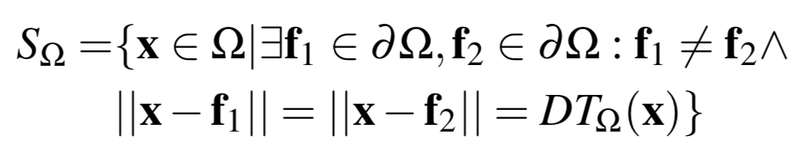
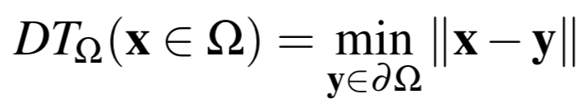
Step 2a: 2D Skeleton Computation
distance transfrom
Siddiqi and Pizer (2008) Medial Representations: Mathematics, Algorithms and Applications; Springer.
Rosenfeld and Pfaltz (1968) Distance functions in digital pictures; Pattern Recognition.
Notes:
From the current view, we compute a 2D skeleton, as follows.
First, we extract the so-called silhouette of this view. This is simply a binary image with 1 at all pixels where the scene renders in the framebuffer and 0 elsewhere (that is, where we have the background). This is easy to do – we just grab (copy) the framebuffer image; if we know that the background color (white, in the above example) differs from the scene color (gray, in the above example), then separating the silhouette from the background is immediate. Alternatively, we can also read the depth buffer (Z buffer) of the rendering: All pixels where the Z buffer has a value different from the default, are silhouette pixels.
Next, we compute the boundary of the silhouette (denoted ‘partial Omega’ in the image). These are simply all silhouette (foreground) pixels having at least one background neighbor pixel. The silhouette is the black horse outline in the image above.
Next, we compute the 2D skeleton S of the boundary. The formal definition is given above: The skeleton contains all pixels x in the silhouette that are centers of maximally-inscribed disks. These disks touch the boundary at minimally two points. These points, called f1 and f2 above, are also called feature points of the skeleton-point x.
Note also that the distance from a skeleton point x to its feature points (f1, f2) is also called the distance transform of the silhouette at point x, denoted DT(x)
We can compute the skeleton, distance transform, and feature points precisely, for any 2D silhouette, and in real-time (100 frames-per-second or more at full-screen resolution) using a CUDA implementation. For details, see the paper and provided code.

Slide 8
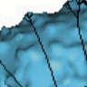
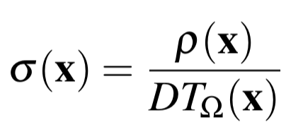
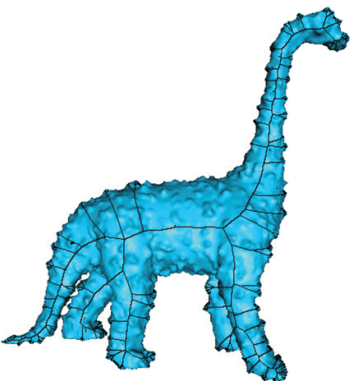
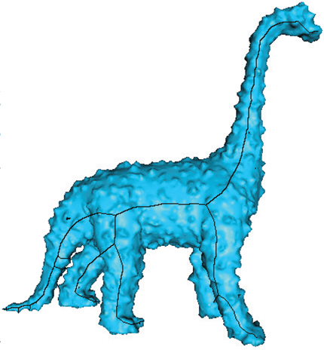
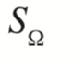
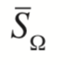
Step 2b: 2D Skeleton Simplification
ρ
f₂
f₁
DT(x)
skeleton point x
Raw skeleton with noise-induced branches
Saliency-regularized skeleton
Telea (2011) Feature preserving smoothing of shapes using saliency skeletons; Springer.
Telea and van Wijk (2002) An augmented fast marching method for computing skeletons and centerlines; Springer.
Notes:
One well-known problem of computing 2D skeletons is that they are noise-sensitive: Any small-scale ‘bump’ along the boundary of the shape will create a skeleton branch. This is shown in the left image, where the input shape is, on purpose, chosen to be noisy. These so-called noise branches of the skeleton are useless – we don’t want them next in our pipeline.
Luckily, it’s very easy to eliminate these noise branches. The process is known as regularization, and delivers a regularized skeleton ‘S bar Omega’. The regularized skeleton for our noisy dino shape is shown in the right image. As visible, the main branches, corresponding to the legs, neck, and tail, are preserved. All other noise-induced branches are eliminated.
To do this regularization, we compute a so-called saliency metric sigma (x) for every skeleton pixel x. Sigma equals the importance rho of the pixel x (that is, length of boundary between the two feature points of x) divided by the distance-transform of x, i.e., DT(x)). See the example in the zoomed-in detail in the left figure. Here, for the red skeleton point x, we marked in yellow its two feature points f1, f2. The green arc is the importance rho of x. And the distance transform is shown in yellow. As shown in [Telea, 2011], sigma is low on noise-induced branches, but high all over the main skeleton branches. Indeed, for our example, if we divide the green length by the yellow length, we obtain a low salience sigma for our skeleton point x.
So, simply thresholding sigma by a fixed value (around 1.0) eliminates noise branches but fully keeps the salient (important) branches.

Slide 9
Step 3: Computing Rotation Axis
Notes:
So far, we have computed a 2D skeleton for the silhouette of our 3D scene. We now need to extract somehow a 3D rotation axis from this.
One way to do this would be to extract a full 3D curve-skeleton from the 2D skeleton. There are many methods for doing this (see the paper for references). However, these are all slow, complicated to implement, and have strong requirements on the 3D scene (for example, the 3D scene should consist of a single connected object, without holes, with no self-intersecting polygons, and consisting of a mesh of high quality). We have no such requirements for our scene. Moreover, we only have a 2D rendering of the scene.
So, we work differently: Instead of extracting a full 3D skeleton of the scene, we only want to extract a local line-approximation of this 3D skeleton. For this, we proceed as follows:
Let p be a 2D point of interest, indicated by the user by clicking with the mouse somewhere close to the silhouette. This is the blue point in the above drawing.
We next find s_p, the closest pixel in the 2D skeleton, to p. This is the anchor point, in light blue, in the drawing.
Let next N(s_p) be the pixel neighbors, in the 2D skeleton, of s_p. We select roughly 30..40 such neighbors (the exact number is not important). These are the red points in the drawing.
Then, for each such neighbor, we estimate its depth (Z coordinate) using the information in the Z buffer of the current rendering. We discuss this in more detail in the next slide
Finally, we estimate a 3D axis of rotation simply as the major eigenvector of the covariance matrix of the 3D coordinates of the neighbor-points N(s_p). This is the dotted line in the drawing.
So now, we have a 3D rotation axis, so we can rotate the shape around it. We designed several rotation modes, which we will explain next.

Slide 10
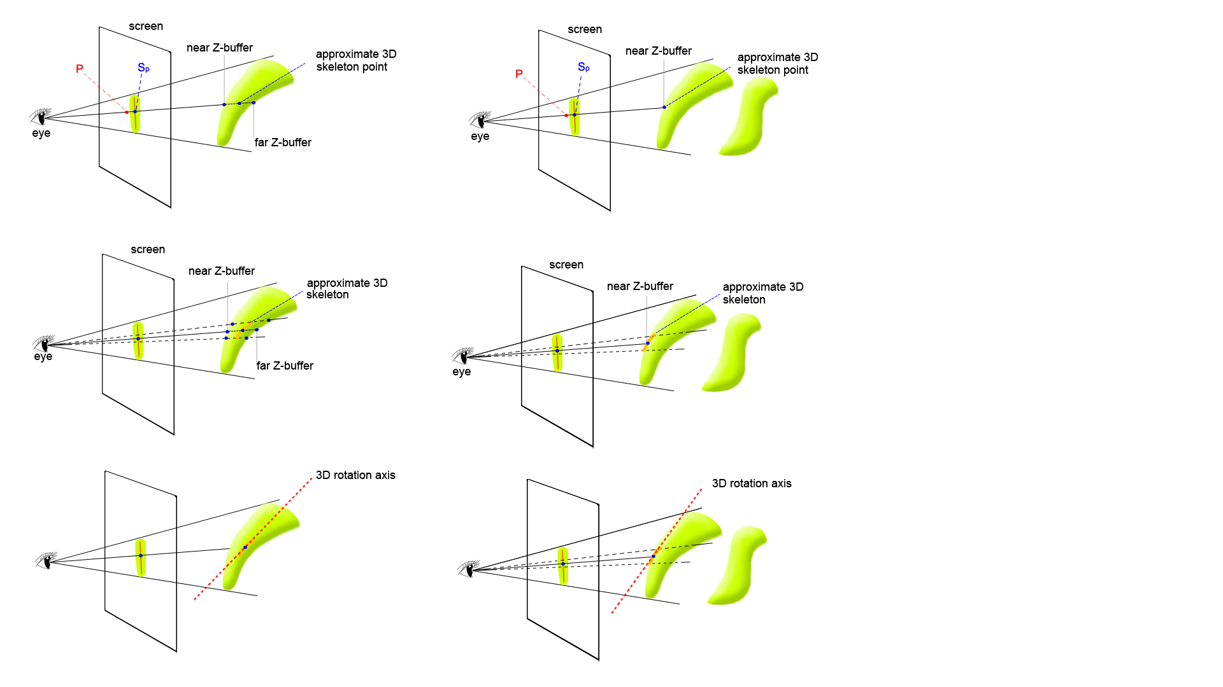
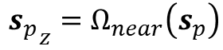
Closed shape
Open shape
p： clicked point
${s_{p}}_{z}=$ $Ω_{near}\left(s_{p}\right)$
Notes:
So let’s explain how to estimate a depth for a 2D skeleton pixel. There are two situations here: At the current point (x), the rendered scene is closed, or open. We explain this next.
We render the 3D scene twice, once with the GL_LESS, and once with the GL_GREATER depth-tests enabled. This creates two Z buffers: one, Z_near, records the position of the closest fragments to the viewpoint; the other, Z_far, records the position of the farthest fragments to the viewpoint. For the first test, we also cull the backfacing polygons; for the second test, we cull the front-facing polygons. In case of a typical closed shape (see left images), we get two values Z_near and Z_far that are both different from the ‘default’ value of the Z buffer. In this case, we estimate the depth of the skeleton pixel simply by averaging these, i.e., (Z_near+Z_far)/2.
In this case, the rotation axis will be located somewhere ‘inside’ the shape. Note that the EXACT position of this axis is not important for our purposes: We only want to rotate around the current shape part, and not EXACTLY around the CENTER of this shape part.
In case of an open shape at the current pixel x, there’s only a front-facing fragment at x, but no back facing fragment behind. So, in this case, Z_far will have the default Z value, as set by the clearing of the Z buffer. If we identify this case (by comparing Z_far with the default Z value), we simply set the depth of the pixel x to Z_near. This case is illustrated in the right images.
In this case, the rotation axis will be located ‘on the visible surface’ of the current shape part (roughly speaking). Sure, this is less than ideal, but it’s a very good approximation for rotating around the current shape part, which can be computed robustly and easily.

Slide 11
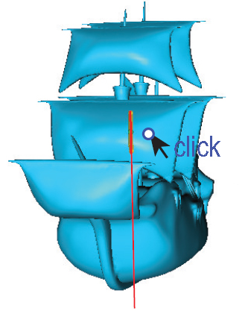
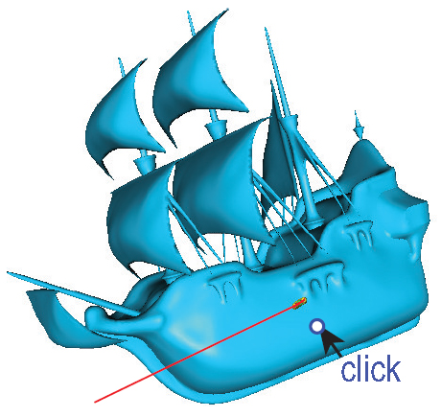
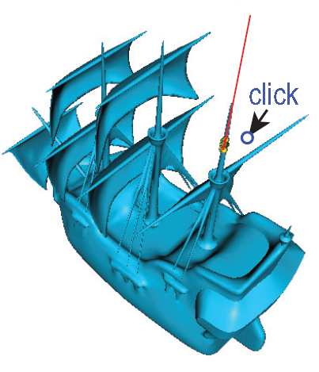
Step 4: Control the rotation
Method 1: Indication
shows you where is the 3D axis of the rotation
Notes:
Now that we have a 3D rotation axis, we also need a way to control the rotation. We provide several mechanisms for this, as follows.
First, we have an indication mode: If we move the mouse pointer with a control key pressed, we do not rotate, but continuously update the display of the closest skeleton pixels N(s_p), the ones used for computing the rotation axis, and the actual estimated rotation axis. The neighbor points are shown by the thick red curve in the images, and the rotation axis by the thin red line.
This lets the user see around which line would the shape rotate if we started the rotation at the current point. If the user likes the rotation axis, she can start it (we explain this on the next slides); if not, the user moves the mouse pointer to some different point, until she finds a rotation axis she likes.

Slide 12
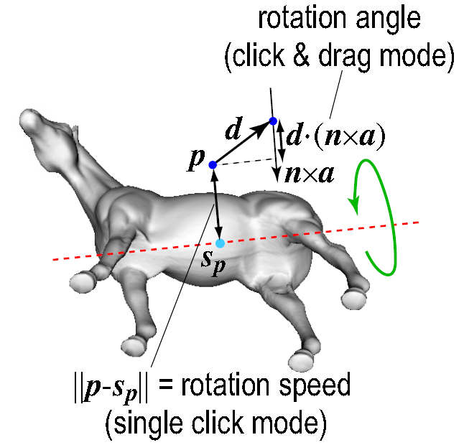
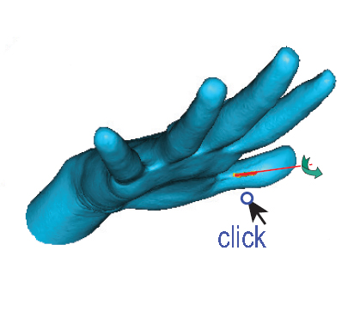
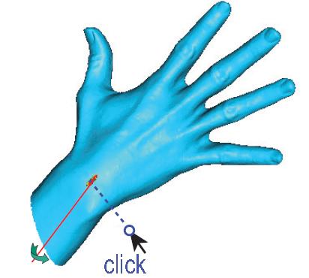
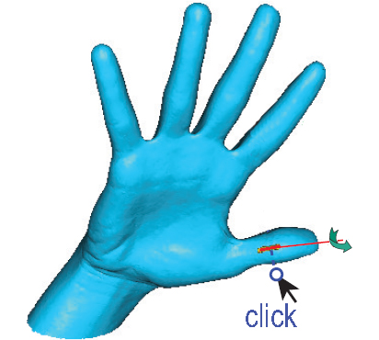
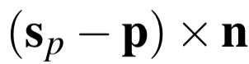
Step 4: Control the rotation
Method 2: Single Click
Just one click, and then spin around the axis
For presentation mode
rotation direction: sign of
Notes:
OK, so let’s say we found a nicely-looking rotation axis. We can now start the rotation. We offer two ways for doing this as follows.
The first mode is single click: The user just clicks and waits. The shape is then rotated continuously in the direction given by the sign of the cross-product (s_p - p) x n, where p is the clicked point, s_p is the closest skeleton-point to p, and n is the view-plane normal. In simple words, the rotation direction depends on which side of the rotation axis (dotted line) the clicked point p lies.
The rotation speed is given by how far from the shape we click, i.e., the distance ||p – s_p||. Clicking far from the shape rotates faster, so as to see quicker what’s on the other side. Clicking closer means we’re interested in more details, so we rotate slower.
This mode is useful for exploring/presenting a scene, as the scene continuously spins (rotates) as long as the mouse button is pressed.

Slide 13
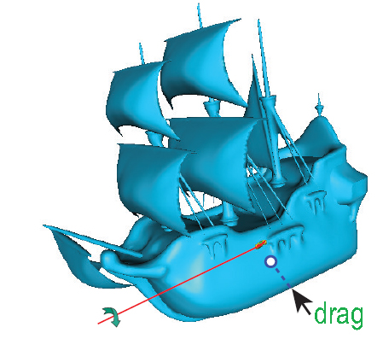
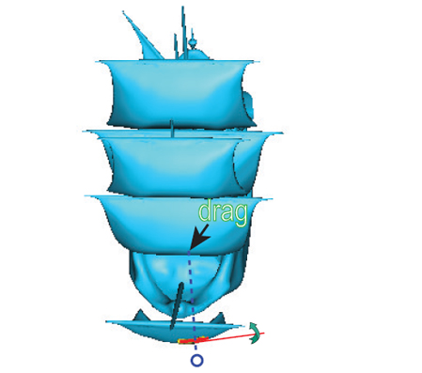
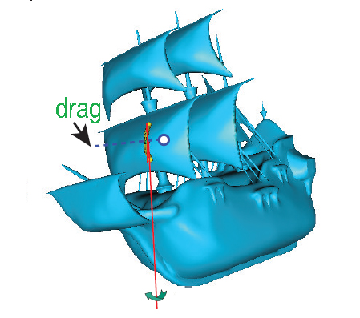
Step 4: Control the rotation
Method 3: Click and Drag
For accurate rotations
Notes:
In the second mode, we want to control the rotation more carefully: For this, we click and drag the mouse, as usual in 3D manipulation.
Let p be, again, the clicked point. Let d be the drag vector (how much and in which direction we drag the mouse). Then, we rotate with an angle equal to d ( n x a). That is: if we drag more, the rotation angle becomes larger. Also, only the drag component which is perpendicular to the rotation axis a, i.e., along the vector n x a, counts. So, mouse motions parallel to the rotation axis a don’t cause any rotations, as one would expect.

Slide 14
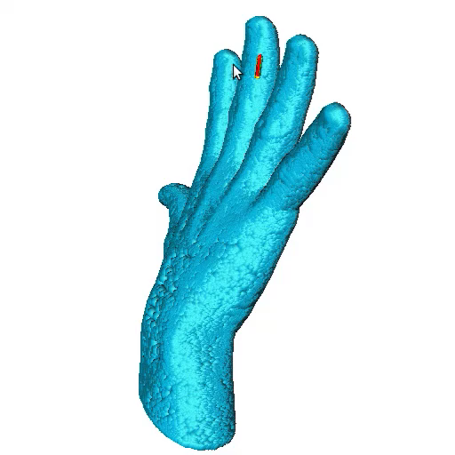
Results
Example 1: Simple shape
Hand mesh:
49374 vertices
98496 triangles
Open mesh
Notes:
Let’s now show some examples:
We start with a simple shape – a hand scan having about 50 thousand vertices and 100 thousand faces (triangles). Note that this is an open mesh – the hand is not closed at the wrist (the mesh has a hole there). This demonstrates how our method can handle non-watertight meshes.

Slide 15
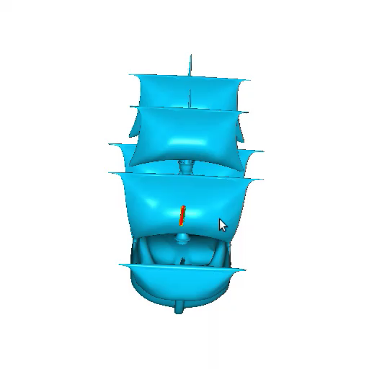
Results
Example 2: Complex Model
Ship:
180K vertices
380K faces
Multiple part model with (self) intersections
Notes:
We now show a more complex example:
A ship model, having about 180K vertices and 380K faces. This is a complex model: the model has multiple parts (masts, sails, ropes, hull), some are very thin, tube-like (masts, ropes); some are surface like (sails); and some are volumetric (hull). These elements are not connected (they don’t form a single surface), and they actually intersect and self-intersect, and the polygons have very different sizes. By using this model, we demonstrate that our method can handle any kinds of 3D scenes, even unorganized polygon collections.

Slide 16
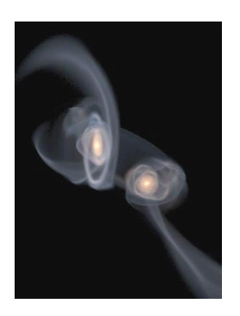
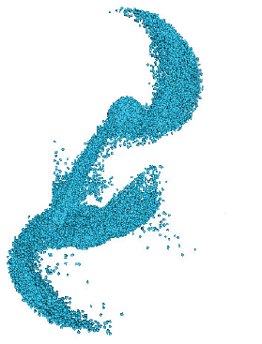
Results
Example 3: Point cloud
using spherical splats
a) Volume-rendered overview
b) Our method’s rendering
J. Dubinski (2006) GRAVITAS: Portraits of a universe in motion; https://www.cita.utoronto.ca/~dubinski/galaxydynamics/gravitas.html.
Notes:
Our third example is again different: This is a 3D point cloud having about 160K points. The points represent the positions of stars and dark matter in the simulation of a collision between the Milky Way and the nearby Andromeda Galaxy, in an astronomical research project.
Hence, here we don’t even have surfaces, just a point cloud of a complex shape and variable density.
To handle this by our method, we render the point cloud by replacing every point by a small constant-radius spherical splat geometry. The left image shows the point cloud, rendered with volume rendering (for illustration purposes, we don’t actually use volume rendering in our application); the right image shows the point cloud rendered by spherical splats. The radius of the splats makes the spheres overlap in the 2D view, so, they create a silhouette, which we next can use to compute 2D skeletons, just as for the other shapes shown earlier.

Slide 17

Notes:
Let’s now show a video demonstrating our method.
RUI: during the video play, make sure you EXPLAIN what people are looking at!!

Slide 18
Discussion
Ease of use: Just one click and drag
Generic: works for any 3D scene
Novelty: 2D skeletons for 3D rotation
Efficiency: simple (OpenGL 1.1), fast (100 fps)
Open source:
http://www.staff.science.uu.nl/~telea001/pmwiki.php/Shapes/CUDASkelInteract
Notes:
Let’s again discuss the main features of our method:
It is easy to use: to rotate in 3D, one just needs to click and optionally drag; so, it’s as easy to use as e.g. the trackball; but, of course, it offers much better rotation control than trackball, and more freedom of rotation than axis-aligned rotation
It is generic: it can handle any 3D scene (polygon meshes, unorganized polygon soups, point clouds, combinations of these, with no restriction of polygon size, or connectivlty, or intersections). As long as the scene renders into the framebuffer and Z buffers, we can handle it
It is, to our knowledge, the first time 2D image skeletons have been used to create interactive 3D rotations of 3D scenes. Note, again, that we don’t need a full 3D curve-skeleton, which is complex and slow to compute.
It is fast and simple to implement: We only use OpenGL 1.1 (available on any device today), and we can interact with scenes of hundreds of thousands of polygons in real-time on consumer-grade hardware
The code of the method is open source, see the link below (also added in the paper). Feel free to use it!

Slide 19
Thank you for your interest!
Future Work
Evaluation: tasks, user study
Accuracy: better 3D skeletons for 2D views
x.zhai@rug.nl
Notes:
We plan to extend our work in several directions:
First, we plan to conduct formal user studies to see for which exact tasks our method is better than existing rotation methods (trackball, axis-aligned), and by how much (accuracy and timing need to be measured).
Next, we plan to extend the accuracy of the estimation of 3D rotation axes from single views. We believe that it is possible to use additional heuristics to better place the 3D rotation axis inside the parts of the rendered shape.
This concludes the presentation. Thank you for your interest, and you can contact me by mail for any details next!

